Slide 2
MOUNTAINVIEW
TRIVIA
COMING UP NEXT . . .

Slide 3
MOUNTAINVIEW
TRIVIA
TEAMS OF UP TO 8 PEOPLE
THINK OF AN ORIGINAL TEAM NAME
EAT - DRINK - BE SMART

Slide 5
MOUNTAINVIEW
TRIVIA
ROUND #1
THE MAN AND THE MOVIES

Slide 6
QUESTION 1
How many Academy Awards did The Lord of the Rings trilogy win?
NINE
ELEVEN
SEVENTEEN
TWENTY-ONE

Slide 7
QUESTION 2
In what month were all the 'Lord of the Rings' movies released?
DECEMBER
MARCH
SEPTEMBER
NOVEMBER

Slide 8
QUESTION 3
Who directed an animated version of The Lord of the Rings in 1978?
DON BLUTH
TEX AVERY
RALPH BAKSHI
WALT DISNEY

Slide 9
QUESTION 4
In what country was J.R.R. Tolkien born?
ENGLAND
WALES
SOUTH AFRICA
GERMANY

Slide 10
QUESTION 5
How many children did 'Lord of the Rings' author J. R. R. Tolkien have?
ONE
TWO
THREE
FOUR

Slide 11
QUESTION 6
Who created the score for the 'Lord of the Rings' movies?
JOHN WILLIAMS
HANS ZIMMER
HOWARD SHORE
DANNY ELFMAN

Slide 12
QUESTION 7
In what year was the first 'Lord of the Rings' book published?
1943
1954
1958
1961

Slide 13
QUESTION 8
Tolkien wrote The Lord Of The Rings while teaching at which university?
CAMBRIDGE
EDINBURGH
HARVARD
OXFORD

Slide 14
MOUNTAINVIEW
TRIVIA
BREAK TIME . . .

Slide 15
MOUNTAINVIEW
TRIVIA
ROUND #2
COMPLETE THE QUOTE

Slide 17
QUESTION 1
“Not all those who wander are _______.”
- Bilbo Baggins
LOST

Slide 18
QUESTION 2
SMALLEST
“Even the ________ person can change the course of the future.”
-Galadriel

Slide 19
QUESTION 3
"A wizard is never late,
______ _______.
Nor is he early; he arrives precisely when he means to."
- Gandalf
FRODO BAGGINS

Slide 20
QUESTION 4
"_______!
Boil 'em, mash 'em, stick 'em in a stew."
- Samwise Gamgee
POTATOES

Slide 21
QUESTION 5
"There can be no trust between hammer and ______."
-King Durin III
ROCK

Slide 22
QUESTION 6
“What about second _________?”
-PIPPIN
BREAKFAST

Slide 23
QUESTION 7
“They say only: The Doors of Durin, Lord of Moria. Speak, ______, and enter.” - Gandalf
FRIEND

Slide 24
QUESTION 8
“They stole it from us. Sneaky little ___________.
Wicked, tricksy, false!”
- Gollum
HOBBITSES

Slide 25
MOUNTAINVIEW
TRIVIA
BREAK TIME . . .

Slide 26
MOUNTAINVIEW
TRIVIA
ROUND #3
3 RINGS FOR THE ELVEN KINGS

Slide 27
QUESTION 1 - Two Parter
How many Rings of Power were there in total?
How many did Sauron make?
20 IN TOTAL
SAURON MADE ONLY ONE

Slide 28
QUESTION 2
What is the name of the tower where Sauron resides?
Barad-dûr
the Dark Tower

Slide 29
QUESTION 3
What’s the name of the Elvish language that is frequently used in the “Lord of the Rings”?
SINDARIN

Slide 30
QUESTION 4
What is the name of the seeing-stone used by Saruman and later by Pippin?
THE PALANTIR

Slide 31
QUESTION 5
What is the Elvish word for friend, which also serves as the password to the doors of Moria?
MELLON

Slide 32
QUESTION 6
What is the name of Gandalf’s horse?
SHADOWFAX

Slide 33
QUESTION 7
What is the name of Aragorn’s sword?
Andúril

Slide 34
QUESTION 8 - FOR TOLKIEN NERDS - FOR REALS - 2PTS
Who were the two blue wizards that went to the East and were never seen again?
ALATAR & PALANDO

Slide 35
MOUNTAINVIEW
TRIVIA
BREAK TIME . . .

Slide 36
MOUNTAINVIEW
TRIVIA
ROUND #4
MIDDLE EARTH MYSTERIES

Slide 37
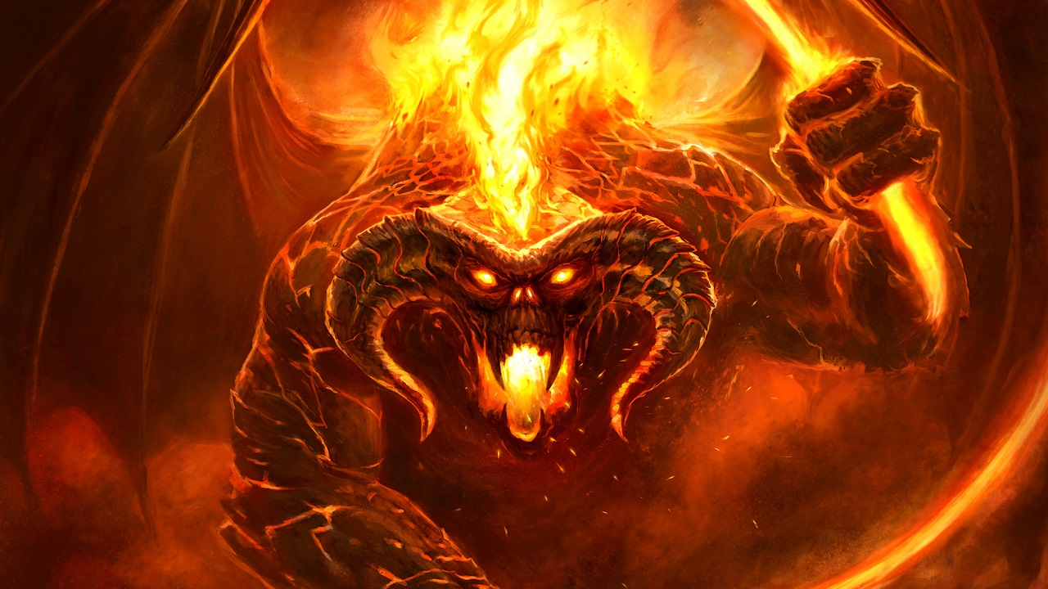
QUESTION 1 - WHO’S IT - WHAT’S IT ??
BALROG
OR DURIN’S BANE

Slide 38
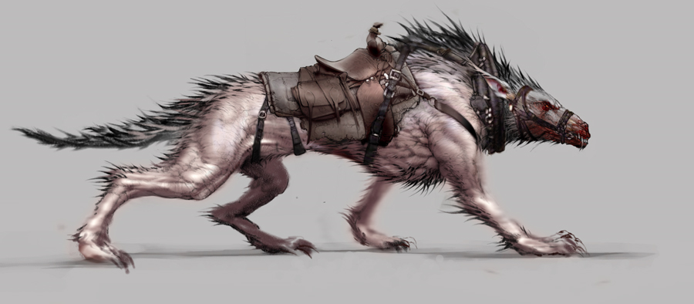
QUESTION 2 - NAME THE CREATURE
WARG

Slide 39
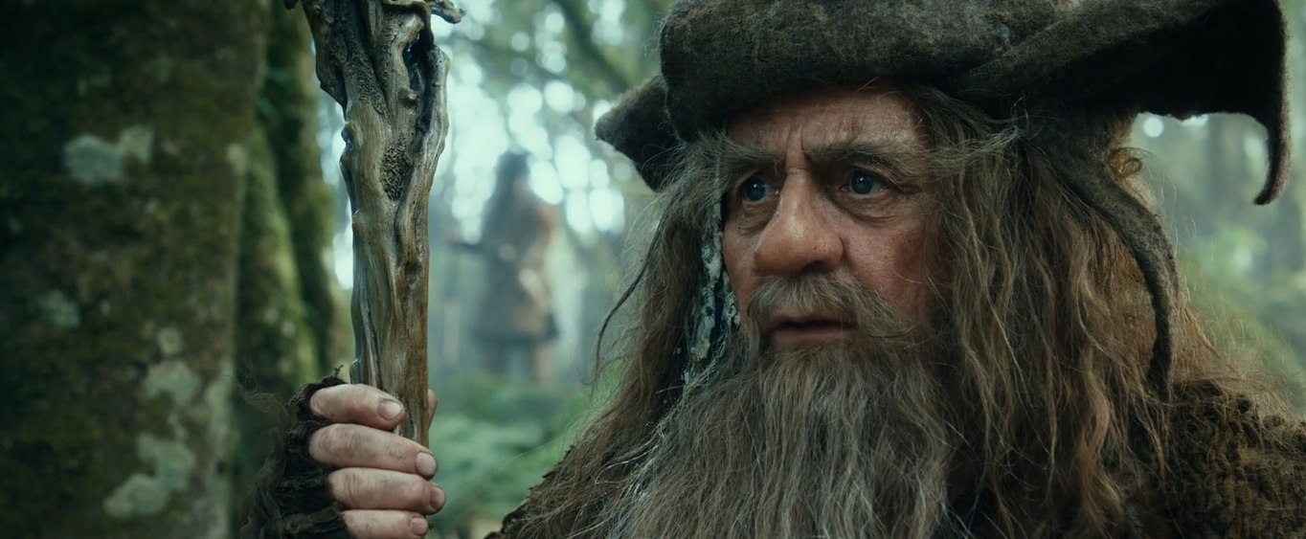
QUESTION 3 - WHO IS THIS?
RADAGAST
THE BROWN

Slide 40
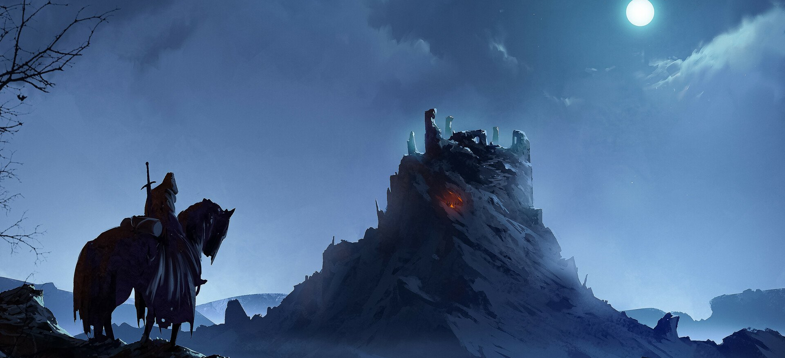
QUESTION 4 - NAME THIS PLACE?
AMON SUL
AKA WEATHERTOP

Slide 41
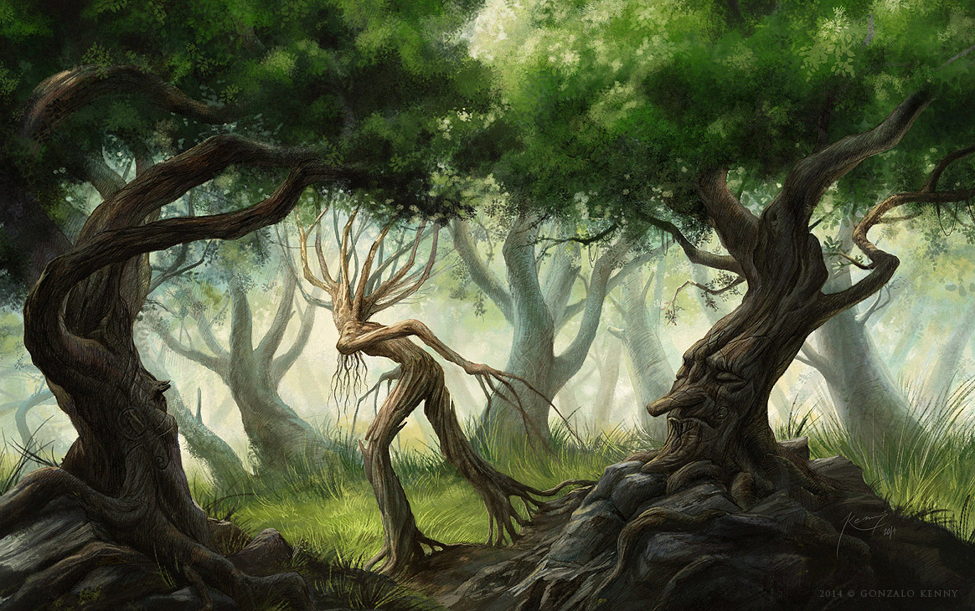
QUESTION 5 - NAME THIS PLACE?
FANGORN
FOREST

Slide 42
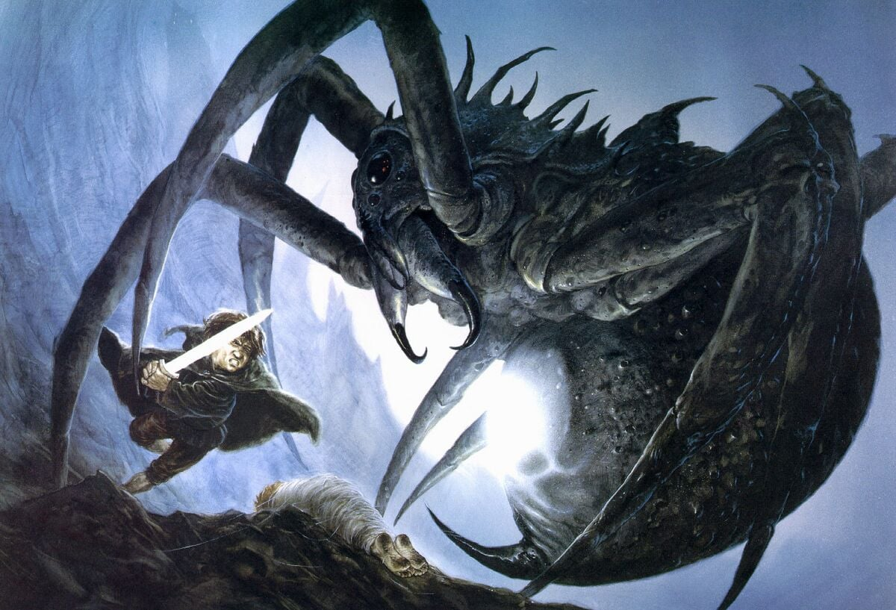
QUESTION 6 - WHAT IS THIS CREATURES NAME?
SHELOB

Slide 43
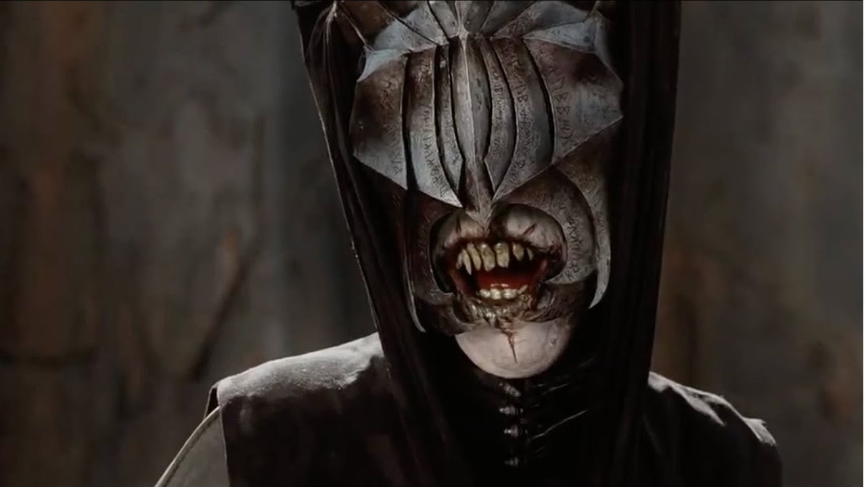
QUESTION 7 - WHAT IS HE CALLED?
THE MOUTH OF SAURON

Slide 44
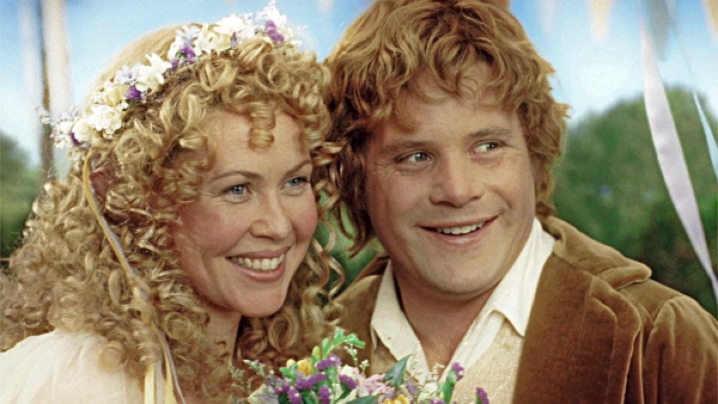
QUESTION 8 - 2 PTS FOR HER FULL MAIDEN NAME
ROSIE COTTON

Slide 45
MOUNTAINVIEW
TRIVIA
BREAK TIME . . .

Slide 46
MOUNTAINVIEW
TRIVIA
BONUS ROUND
PHONOGRAPHIC FANTASY

Slide 47
# 1 - NAME THE SONG & THE ARTIST for 2pts
”7 RINGS”
BY ARIANA GRANDE

Slide 48
# 2 - NAME THE SONG & THE ARTIST for 2pts
”FANTASY”
BY MARIAH CAREY

Slide 49
# 3 - NAME THE SONG & THE ARTIST for 2pts
”SINGLE LADIES
( PUT A RING ON IT )”
BY BEYONCE

Slide 50
# 4 - NAME THE SONG & THE ARTIST for 2pts
”MAGIC”
BY PILOT

Slide 51
# 5 - NAME THE SONG & THE ARTIST for 2pts
”RAMBLE ON”
BY LED ZEPPLIN

Slide 52
# 6 - NAME THE SONG & THE ARTIST for 2pts
”FLY LIKE AN EAGLE”
BY STEVE MILLER BAND

Slide 53
# 7 - NAME THE SONG & THE ARTIST for 2pts
”MAGIC MAN”
BY HEART

Slide 54
# 8 - NAME THE SONG & THE ARTIST for 2pts
”ENEMY”
BY IMAGINE DRAGONS

Slide 55
# 9 - NAME THE SONG & THE ARTIST for 2pts
”RING OF FIRE”
BY JOHNNY CASH

Slide 56
# 10 - NAME THE SONG & THE ARTIST for 2pts
”FANTASY”
BY ALDO NOVA

Slide 57
MOUNTAINVIEW
TRIVIA
TALLYING THE SCORES

Slide 58
MOUNTAINVIEW
TRIVIA
THANKS FOR PLAYING

Slide 59
TIEBREAKER - CLOSEST TO THE CORRECT NUMBER WINS
HOW MANY PAGES IN THE ORIGINAL “THE HOBBIT”?
310

